Slide 1


COMP90049 Knowledge Technologies
Decision Trees (Lecture Set 5)
Rao Kotagiri
School of Computing and Information Systems
The Melbourne School of Engineering
Some of slides are derived from Prof Vipin Kumar and modified, http://www-users.cs.umn.edu/~kumar/

Slide 2
Rule based classification
We need labelled data to build a classifier
Headache | Cough | Temperature | Sore | Diagnosis
severe | mild | high | yes | Flu
no | severe | normal | yes | Cold
mild | mild | normal | yes | Flu
mild | no | normal | no | cold
severe | severe | normal | yes | Flu

Slide 3
Rule based classification
Patient# | Headache | Cough | Temperature | Sore | Diagnosis
p1 | severe | mild | high | yes | Flu
P2 | no | severe | normal | yes | Cold
P3 | mild | mild | normal | yes | Flu
P4 | mild | no | normal | no | cold
p5 | severe | severe | normal | yes | Flu
One good approach is
Construct a decision tree
Extract one rule for each leaf node
Example:
  Rule1: if (headache = severe) then it is Flue
  Rule2: if (headache = mild) and (Sore = yes) then it is Flu
  Rule3: if (headache = mild) and (Sore = no) then it is Cold
  Rule 4: if (headache = no) then it is Cold
Headache
Severe
No
mild
p1, p5
Flu: 2
Cold:0
Sore
p2
Flu:0
Cold:1
Yes
No
p3
Flu:1 Cold:0
p4
Flu:0 Cold:1
Notes:
Rules will be given by experts
Every group has only one class, rule to separate
Each partition will have one

Slide 4
Decision Trees
Patient# | Headache | Cough | Temperature | Sore | Diagnosis
p1 | severe | mild | high | yes | Flu
P2 | no | severe | normal | yes | Cold
P3 | mild | mild | normal | yes | Flu
P4 | mild | no | normal | no | cold
p5 | severe | severe | normal | yes | Flu
Cough
No
Cough
severe
mild
p2, p5
Flu: 1
Cold:1
p1, p3
Flu: 2
Cold:0
p4
Flu: 0
Cold:1
severe
No
mild
Headache
p1, p3
Flu: 2
Cold:0
p4
Flu: 0
Cold:1
severe
mild
No
p5 Flu:1 Cold:0
Flu:0 Cold:0
p2 Flu:0 Cold:1

Slide 5
Decision Trees
Patient# | Headache | Cough | Temperature | Sore | Diagnosis
p1 | severe | mild | high | yes | Flu
P2 | no | severe | normal | yes | Cold
P3 | mild | mild | normal | yes | Flu
P4 | mild | no | normal | no | cold
p5 | severe | severe | normal | yes | Flu
Headache
severe
No
mild
p1, p5
Flu: 2
Cold:0
Sore
p2
Flu: 0
Cold:1
Issues:
How to build optimal Decision Tree?
What does optimality mean?
How to choose attribute values at each decision point (node)?
How to choose number of branches at each node and attribute values for partitioning the data?
When to stop the growth of the tree?
Yes
No
p3 Flu:1 Cold:0
p4 Flu:0 Cold:1
Notes:
My training data will not have errors: optimality

Slide 6
Decision Trees
Issues:
  How to build optimal Decision Tree for a given training data set?
  What does optimality mean (minimal number of nodes!)?
  How to choose attribute values at each decision point (node)?
  How to choose number of branches at each node and attribute values for partitioning the data?
  When to stop the growth of the tree?
Optimal construction of a Decision Tree is NP (non-deterministic polynomial) hard.
So we use heuristics:
Choose an attribute to partition the data at the node such that each partition is as homogeneous (least impure) as possible. This means we would like to see most of the instances in each partition belonging to as few classes as possible and each partition should be as large as possible.
We can stop the growth of the tree if all the leaf nodes are largely dominated by a single class (that is the leaf nodes are nearly pure).
Headache
severe
No
mild
p1, p5
Flu: 2
Cold:0
Sore
p2
Flu: 0
Cold:1
Yes
No
p3 Flu:1 Cold:0
p4 Flu:0 Cold:1
Notes:
NP hard problem : try every node

Slide 7
Decision Trees
Headache
Measures of Node Impurity
Gini Index
Entropy
Misclassification error
severe
No
mild
p1, p5
Flu: 2
Cold:0
Sore
p2
Flu: 0
Cold:1
Yes
No
p3 Flu:1 Cold:0
p4 Flu:0 Cold:1

Slide 8

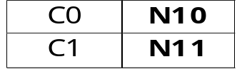
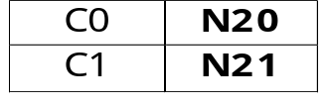


How to Find the Best Split
M0 (some measure of impurity)
Before Splitting:
Node N0: A?
Yes
No
Node N0: B?
Node N1
Node N2
Yes
No
Node N3
Node N4
M1
M2
M3
M4
M12
M34
Gain = (M0 – M12) vs (M0 – M34)
Where M is some measure of impurity (discussed later).

Slide 9

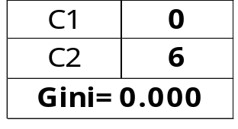
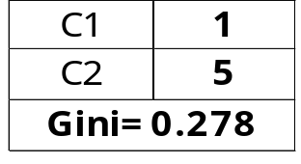
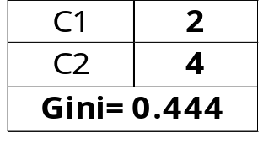
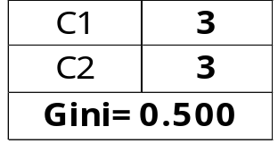
One Measure of Impurity: GINI Index
Gini Index for a given node t :
    (Where p( j | t) is the relative frequency of class j at node t).
  Maximum value of Gini index = (1 - 1/n_{c}) when records are equally distributed among all classes, implying least interesting information or most impure.
  Minimum is (0.0) when all records belong to one class, implying most interesting information or most pure or most homogeneous
  Examples:
1 – (0/6)²-(6/6)² = 0 1- (1/6)²-(5/6)² = 0.278 1- (2/6)²-(4/6)²= 0.444 1 – (3/6)² – (3/6)² = 0.5

Slide 10
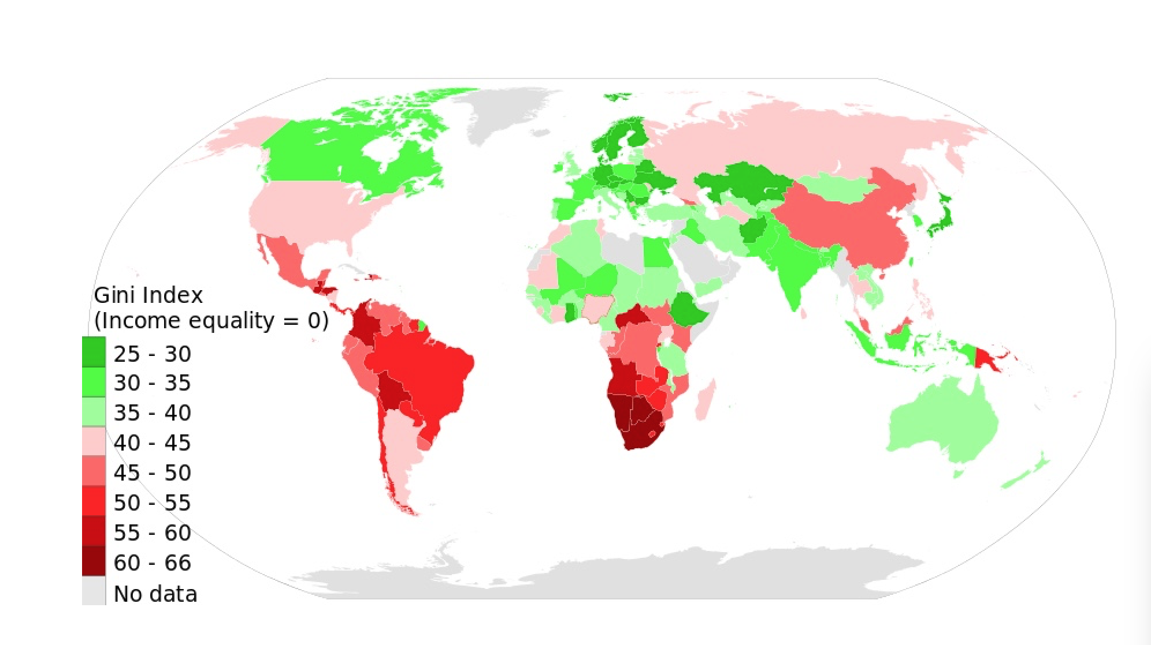
GINI INDEX of Countries
Half of world's wealth now in the hands of 1% of population (Wednesday 14 October 2015, The Guardian)

Slide 11
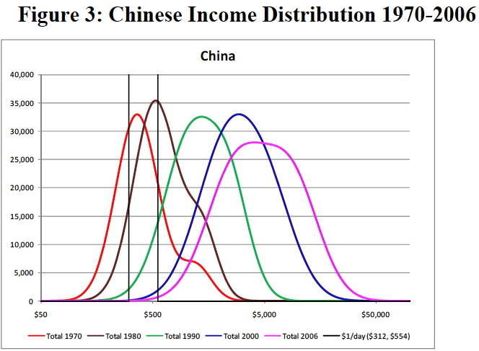
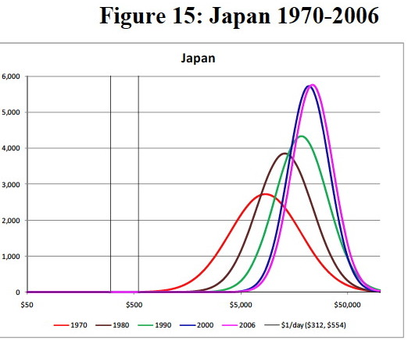
Wealth Distribution
Geni Index Japan 32.11% (in 2008) China 42.06 (in 2010)

Slide 12
Gini coefficient is unable to discern the effects of structural changes in populations^{[53]}
Income bracket (in 2010 adjusted dollars) | % of Population 1979 | % of Population 2010
Under $15,000 | 14.6% | 13.7%
$15,000 – $24,999 | 11.9% | 12.0%
$25,000 – $34,999 | 12.1% | 10.9%
$35,000 – $49,999 | 15.4% | 13.9%
$50,000 – $74,999 | 22.1% | 17.7%
$75,000 – $99,999 | 12.4% | 11.4%
$100,000 – $149,999 | 8.3% | 12.1%
$150,000 – $199,999 | 2.0% | 4.5%
$200,000 and over | 1.2% | 3.9%
Total Households | 80,776,000 | 118,682,000
United States' Gini on pre-tax basis | 0.404 | 0.469

Slide 13

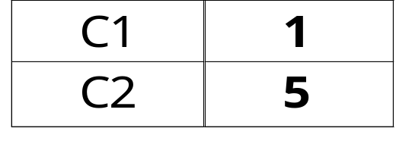
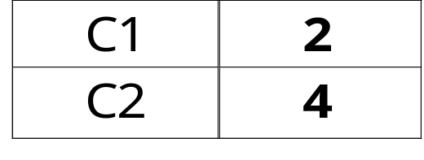
Examples for computing GINI
P(C1) = 0/6 = 0 P(C2) = 6/6 = 1
Gini = 1 – P(C1)² – P(C2)² = 1 – 0 – 1 = 0
P(C1) = 1/6 P(C2) = 5/6
Gini = 1 – (1/6)² – (5/6)² = 0.278
P(C1) = 2/6 P(C2) = 4/6
Gini = 1 – (2/6)² – (4/6)² = 0.444

Slide 14

Splitting Based on GINI
Used in CART, SLIQ, SPRINT.
When a node p is split into k partitions (children), the quality of split is
computed as,
where, n_{i} = number of records at child i,
n = number of records at parent node p.
If GINI(j) – GINI split (j) > delta then split the node j.

Slide 15

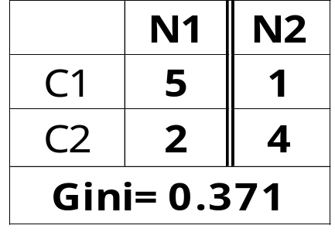
Binary Attributes: Computing GINI Index
Splits into two partitions
Effect of Weighing partitions:
  Larger and Purer Partitions are sought for.
B?
Yes
No
Node N1
Node N2
Gini(N1)
= 1 – (5/7)² – (2/7)²
= 0.408
Gini(N2)
= 1 – (1/5)² – (4/5)²
= 0.32
Average Gini(Children)
= 7/12 * 0.408 +
5/12 * 0.32
= 0.371

Slide 16
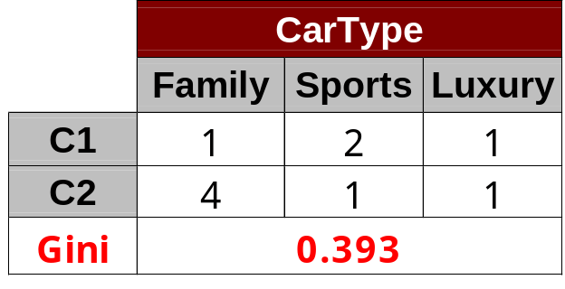


Categorical Attributes: Computing Gini Index
For each distinct value, gather counts for each class in the dataset
Use the count matrix to make decisions if the parent node has instances: 5 Family;
3 Sports and 2 Luxury its Gini Index is 0.62.
Multi-way split
Two-way split
(find best partition of values)

Slide 17

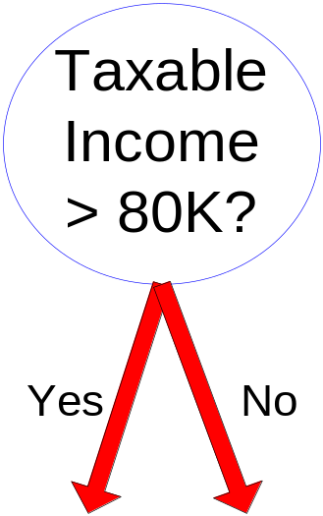
Continuous Attributes: Computing Gini Index
Use Binary Decisions based on one value
Several Choices for the splitting value
  Number of possible splitting values
  = Number of distinct values
Each splitting value has a count matrix associated with it
  Class counts in each of the partitions, A < v and A ≥ v
Simple method to choose best v
  For each v, scan the database to gather count matrix and compute its Gini index
  Computationally Inefficient! Repetition of work.
Notes:
Carry about the efficient

Slide 18
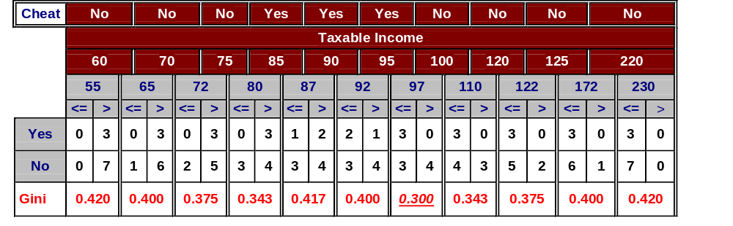
Continuous Attributes: Computing Gini Index...
For efficient computation: for each attribute,
  Sort the attribute on values
  Linearly scan these values, each time updating the count matrix and computing Gini index at points where class label changes (at points A and B)
  Choose the split position that has the least Gini index
A
B
Sorted Values
Split Positions

Slide 19
Alternative Splitting Criteria based on INFORMATION gain
Entropy at a given node t:
    (Where p( j | t) is the relative frequency of class j at node t).
  Measures homogeneity of a node.
    Maximum (log n_{c}) when records are equally distributed among all classes implying high impurity
    Minimum (0.0) when all records belong to one class, implying least impurity
  Entropy based computations are similar to the GINI index computations

Slide 20
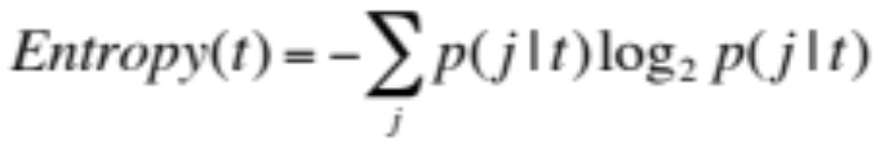
Examples for computing Entropy
P(C1) = 0/6 = 0 P(C2) = 6/6 = 1
Entropy = – 0 log 0 – 1 log 1 = – 0 – 0 = 0
P(C1) = 1/6 P(C2) = 5/6
Entropy = – (1/6) log₂ (1/6) – (5/6) log₂ (1/6) = 0.65
P(C1) = 2/6 P(C2) = 4/6
Entropy = – (2/6) log₂ (2/6) – (4/6) log₂ (4/6) = 0.92

Slide 21
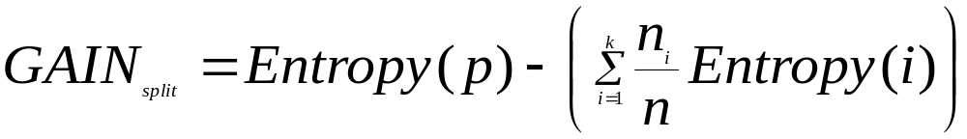
Splitting Based on INFO...
Information Gain:
    Parent Node, p is split into k partitions;
    n_{i} is number of records in partition i
  Measures Reduction in Entropy achieved because of the split. Choose the split that achieves most reduction (maximizes GAIN)
  Used in ID3 and C4.5 (Decision Tree software)
  Disadvantage: Tends to prefer splits that result in large number of partitions, each being small but pure.

Slide 22

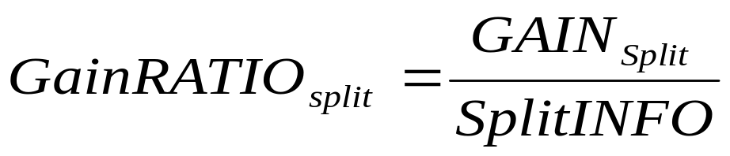
Splitting Based on INFO...
Gain Ratio:
    Parent Node, p is split into k partitions
    n_{i} is the number of records in partition i
  Adjusts Information Gain by the entropy of the partitioning (SplitINFO). Higher entropy partitioning (large number of small partitions) is penalized!
  Used in C4.5
  Designed to overcome the disadvantage of Information Gain

Slide 23
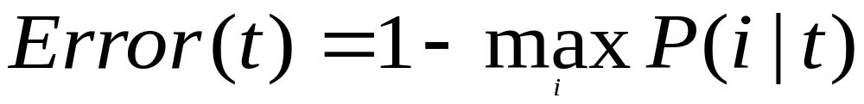
Splitting Criteria based on Classification Error
Classification error at a node t :
Measures misclassification error made by a node.
    Maximum (1 - 1/n_{c}) when records are equally distributed among all classes, implying least interesting information
    Minimum (0.0) when all records belong to one class, implying most interesting information

Slide 24
Examples for Computing Error
P(C1) = 0/6 = 0 P(C2) = 6/6 = 1
Error = 1 – max (0, 1) = 1 – 1 = 0
P(C1) = 1/6 P(C2) = 5/6
Error = 1 – max (1/6, 5/6) = 1 – 5/6 = 1/6
P(C1) = 2/6 P(C2) = 4/6
Error = 1 – max (2/6, 4/6) = 1 – 4/6 = 1/3

Slide 25

Comparison among Splitting Criteria
For a 2-class problem:

Slide 26
Misclassification Error vs Gini
 | Parent
C1 | 7
C2 | 3
Gini = 0.42
MissClass = 0.3
A?
Yes
No
Node N1
Node N2
Gini(N1)
= 1 – (3/3)² – (0/3)²
= 0
Gini(N2)
= 1 – (4/7)² – (3/7)²
= 0.489
MissClass(N1) = 1 –(3/3) = 0
MissClass(N2) = 1 – 4/7 = 3/7
 | N1 | N2
C1 | 3 | 4
C2 | 0 | 3
Gini = 0.342
MissClass =0.3
Gini(Children)
= 3/10 * 0
+ 7/10 * 0.489
= 0.342
Gini improves !!
MissClass =3/10 *0+(7/10)*(3/7)=0.3
Missclassification unchanged!

Slide 27
Tree Induction
Issues
  Determine how to split the records
    How to specify the attribute test condition?
    How to determine the best split?
  Determine when to stop splitting
Greedy strategy
  Choose the Attribute and Splitting test to partition the records that optimizes certain criterion. E.g. GINI index, Entropy, MissClassification Rate.

Slide 28
Stopping Criteria for Tree Induction
Stop expanding a node when all the records belong to the same class. That is the node is pure. One can stop e.g. when the GINI index is close to zero.
Stop expanding a node when all the records have similar attribute values.
This means we cannot partition the data anymore even if the node is impure.
Early termination (to be discussed later)

Slide 29
Decision Making using Decision Tree
Traverse the branch of the decision tree from the root node matching the corresponding attribute values of the test record and the traversal reaches the Leaf Node. Make the decision based on the Leaf Node Class distribution. E.g. label the test data as the class of highest frequency class in the Leaf Node.

Slide 30
Decision Trees
Training Data
Patient# | Headache | Cough | Temperature | Sore | Diagnosis
p1 | severe | mild | high | yes | Flu
P2 | no | severe | normal | yes | Cold
P3 | mild | mild | normal | yes | Flu
P4 | mild | no | normal | no | cold
p5 | severe | severe | normal | yes | Flu
Cough
severe
mild
No
Headache
P1, p3
Flu: 2
Cold:0
p4
Flu: 0
Cold:1
severe
p5 Flu:1 Cold:0
mild
No
Flu:0 Cold:0
p2 Flu:0 Cold:1
Headache
Test data
severe
No
mild
Patient# | Headache | Cough | Temperature | Sore | Diagnosis
px | no | severe | high | yes | ?
p1, p5
Flu: 2
Cold:0
Sore
p2
Flu: 0
Cold:1
Yes
No
p3 Flu:1 Cold:0
p4 Flu:0 Cold:1

Slide 31
Decision Tree Based Classification
Advantages:
  Inexpensive to construct
  Extremely fast at classifying unknown records
  Easy to interpret for small-sized trees
  Accuracy is comparable to other classification techniques for many simple data sets
  No need to scale attribute values.

Slide 32
Example: C4.5
Simple depth-first construction.
Uses Information Gain
Sorts Continuous Attributes at each node.
Needs entire data to fit in memory.
Unsuitable for Large Datasets. But this problem can be addressed easily.
  Needs disk based sorting.
You can download the software from:
http://www.cse.unsw.edu.au/~quinlan/c4.5r8.tar.gz

Slide 33
Practical Issues of Classification
Underfitting and Overfitting
Missing Values
Costs of Classification

